Slide 1
Foreward
To the Reader:
  These slides were created for presentation with verbal explanations, and may not be clear by themselves. ☹
  This set of slides contains both notes and animations. To see animated content and otherwise hidden material, I recommend viewing the slides as a presentation (F5). To see the notes, please View as “Normal”.
David Giandomenico
Notes:
Look here for notes!
-David Giandomenico

Slide 2
Basic Feedback Control
David Giandomenico
Team mentor for
Lynbrook Robotics – Team #846
<DGiandomenico@LynbrookRobotics.com>
Notes:
My intended audience is high school students involved actively in FIRST Robotics.
This talk covers basics of feedback control, together with discussions of practical techniques of measuring position and speed, dealing with changing loads, nonlinearities etc.

Slide 3

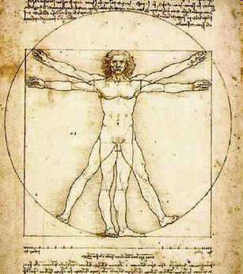
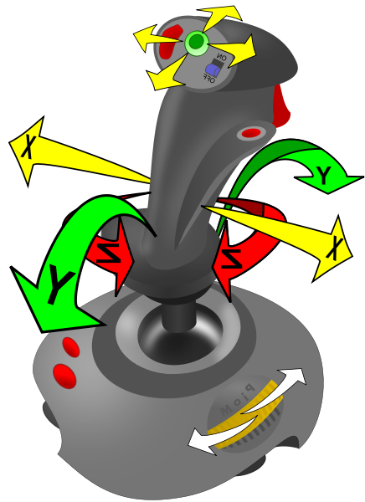
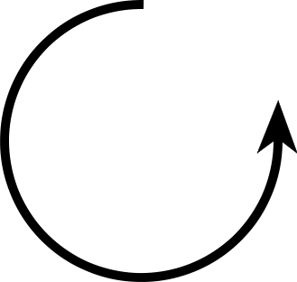
Human Robot Feedback Demo
Notes:
Placeholder for feedback / no feedback
2 volunteers
Ask one volunteer to act as robot, another to act as driver.
Objective: see how the <human driver – robot> loop responds
Instruct human robot to move arm up or down at constant fast speed.
Instruct human driver to command blind human robots arm up/down (only!) to point to target position.
[Expect overshoot and difficulty getting human robot to point to target]
Repeat with human going ‘slow’
Repeat giving human robot “points on clock” directives. [human robot now using ‘closed loop control’]

Slide 4
Expected Human Demo Results Recap
Open Loop
Fast up/down commands → Overshoot
Slow up/down commands → Controllable, but Not Fast
Closed Loop
+ Human robot responds quickly to clock commands
− Limited to resolution of robot’s sensors

Slide 5
Merriam-Webster on “Feedback”
Pronunciation:
  \`fēd-bak\
Function:
  noun
Date:
  1919
1: the return to the input of a part of the output of a machine, system, or process (as for producing changes in an electronic circuit that improve performance or in an automatic control device that provide self-corrective action)
2a: the partial reversion of the effects of blah blah blah
Notes:
Good starting point. People have given careful thought on the meaning. Read it!

Slide 6

Simple System
No Feedback – “Open Loop”
In
A
Out
Notes:
Got to show the basics; Introduce the symbols.

Slide 7
Feedback System
“Closed Loop”
In
+
G
Out
−
H

Slide 8


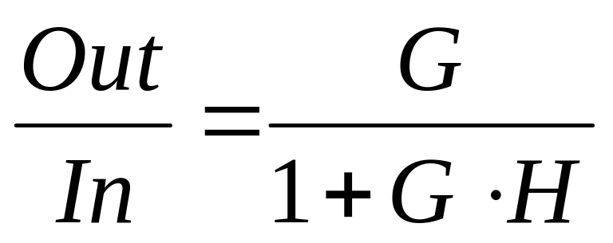
Feedback System
“Closed Loop”
In
+
G
Out
−
H

Slide 9


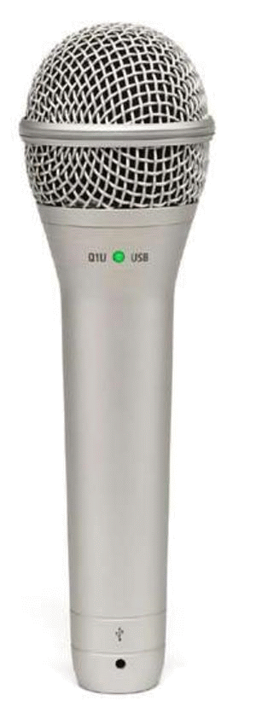

Undesired Feedback Path
Notes:
Pacman singing creates sound pressure at microphone and corresponding electrical signal.
PA amplifier output = gain x input
Speaker turns electrical signal back to sound
Sound is conveyed back to mic. If new sound is greater then original sound then oscillations occur.
In general, oscillations will occur if there exists a frequency such that the “loop gain” is > 1.

Slide 10
Build Schedule
BrainStorm
Not much time!
Need to develop software without robot hardware completed.
On competition field – we must change parameters quickly.
Week 1
BrainStorm
Design
Week 2
Design
Week 3
Design
Build
Week 4
Build
Electronics
Week 5
Build &
Test Software!
Build &
Test Software!
Week 6

Slide 11
Tip: Setting Gain Fast
Option 1: Recompile and upload. Bleah!
Option 2: Attach a potentiometer to an analog input (once adjusted, hardwire in code). Not Bad!
Option 3: Use EEPROM/Flash Memory to save values. Access values through Operator Interface buttons. Display values on robot or OI. Way Cool!

Slide 12
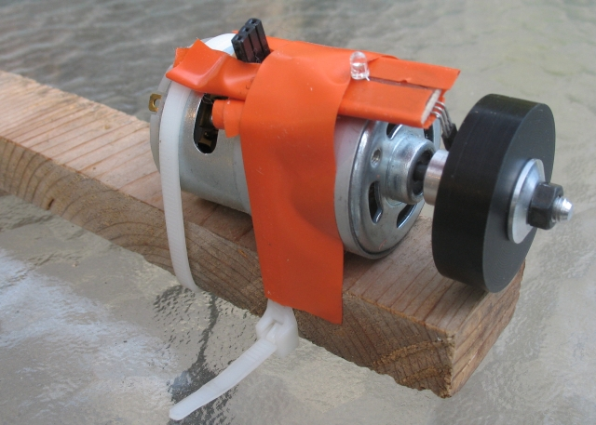
Simple Speed and Position Test Setup
Crude, cheap, but invaluable for testing speed and position control loops!

Slide 13
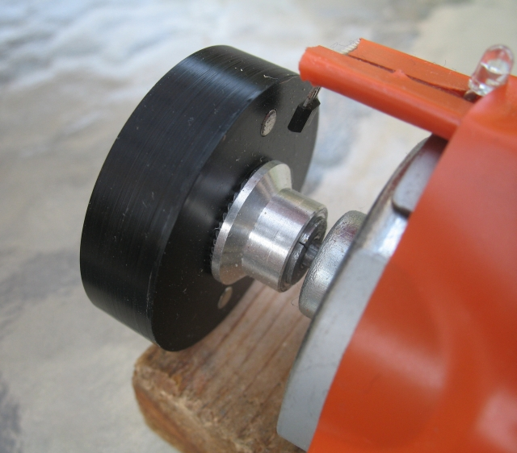
Simple Speed and Position Test Setup
Neodymium Magnet
Qty 2, for balance.
(see the web, eBay!)
Custom disk with holes for shaft and magnets
Hall effect magnetic sensor
<$2 at digikey or mouser
R/C Hobby Prop Adapter, 1/8”

Slide 14
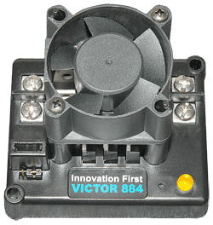
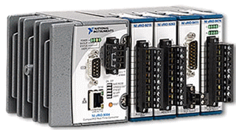
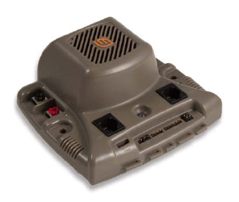

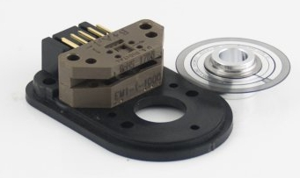
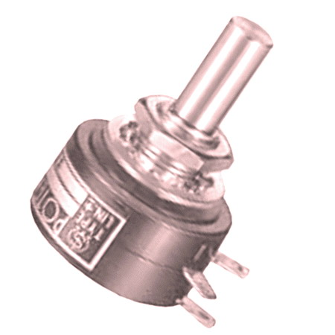
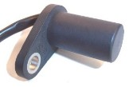
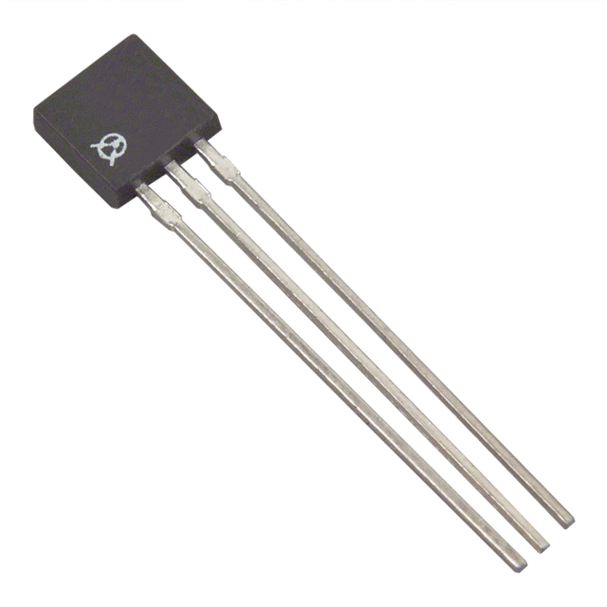
Let’s Build Our FIRST
Closed-Loop Control System
Input Speed
or Position
(joystick,
preset button,
autonomous, etc.)
+
+
G
Out
E.S.C.
−
−
Sensor
Potentiometer, Encoder,
Gear Tooth Sensor,
Hall effect Sensor, …
Yet more sensors:
  Accelerometers & Gyros
  Optical Distance Meas.
  Cameras,
  Ultrasonic
  :
Notes:
Optical encoders, Hall effect (magnetic) sensors, Gear tooth sensors, potentiometers, gyros, …

Slide 15
Closed-Loop Position Control System
+
Input
Position
(joystick,
preset button,
autonomous)
+
Position
Error
Gain
E.S.C.
Out
−
−
Position Sensor
Potentiometer, Encoder Count, Gear Tooth Count, Camera, …
Notes:
Generally the basic Closed-Loop Position System works well for our applications.

Slide 16
Position Controller
Psuedo Code
Wait! Did you know that…
Code on a FIRST robot executes repeatedly about 40× per second†.
Compare this to how you program “procedural tasks” like factorial(n)
Why execute repeatedly?
†FRC2004-08
Allows us to process periodic input data. As a bonus, we can perform multiple motions simultaneously.
.
Notes:
Audience may have no familiarity with programming a FIRST Robot.
Allows us to process periodic input data. As a bonus, we can perform multiple motions simultaneously.

Slide 17
Position Controller
Psuedo Code
int MoveToPosition(int targetPosition)
{
long gain = ReadGainSetting();
long error = targetPosition - ReadPosition();
long toESC = gain * error;
return limit127(toESC); //limit toESC to {-127,127}
}
int MoveToPosition(int targetPosition)
{
long gain = ReadGainSetting();
long error = targetPosition - ReadPosition();
const long kDeadband = 10; //acceptable error
if (absolute(error)<= kDeadBand)
error=0; //We are close enough.
long toESC = gain * error;
return limit127(toESC); //limit toESC to {-127,127}
}
Comments: with a fairly constant load, and enough friction (damping) this simple algorithm may be all you need.
This code is simplified to illustrate the basic concept and requires additional code to limit values.
Notes:
Supporting code in or outside this snippet may further limit the minimum value of ESC to prevent motor ‘stewing’
As long as there is enough friction in the system, and the load is constant, this basic loop will work fairly well.
Click to see addition of Deadband Code.

Slide 18
Closed-Loop Position Control System
Potential Issues:
What happens if we pick up a heavy game piece with our robotic arm?
For a lift, what happens if we are going up versus going down?
For a robotic arm, what happens when we lift from horizontal to vertical?
Notes:
For each of these reasons, we likely need to adjust the gain as the load changes.

Slide 19
Closed-Loop Position Control System
Load Sensor
Holding game target?
Adjust gain based
on target position
+
Input
Position
(joystick,
preset button,
autonomous)
+
Gain
E.S.C.
Out
Position
Error
−
−
Position Sensor
Potentiometer, Encoder Count, Gear Tooth Count, Camera, …
Notes:
Add Load Detector for gain
Add gain based on arm position

Slide 20
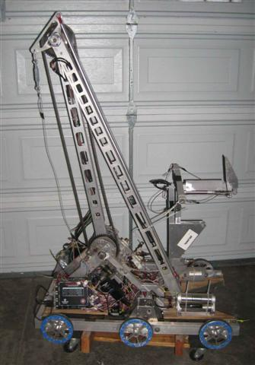
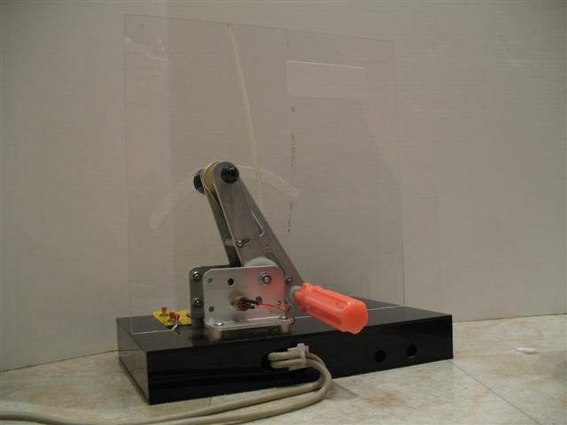
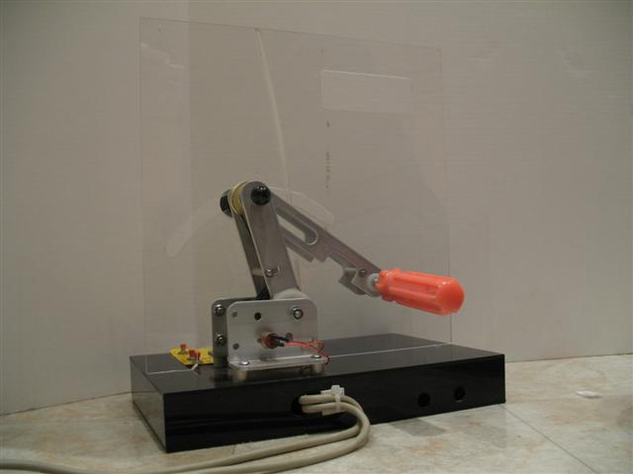
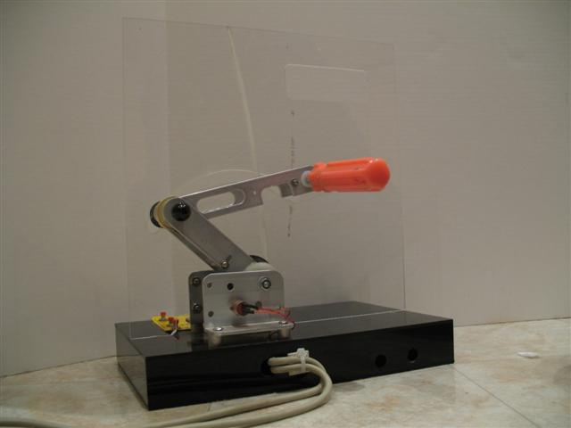
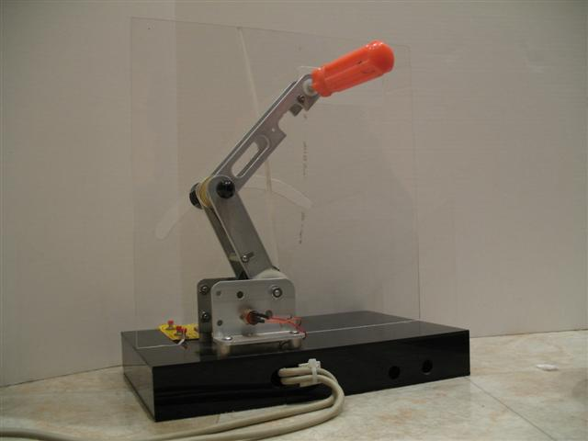
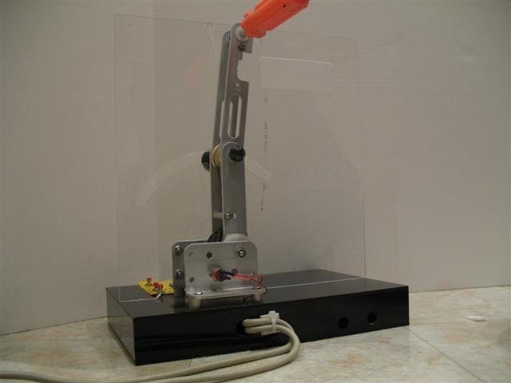
Mirroring Controls
Cool !

Slide 21
Position Controller
Psuedo Code
int MoveToPosition(int targetPosition)
{
long gain = ReadGainSetting();
long error = targetPosition - ReadPosition();
long toESC = gain * error;
return limit127(toESC); //limit toESC to {-127,127}
}
int MoveToPosition(int targetPosition)
{
long gainUp = ReadGainUpSetting();
long gainDown = ReadGainDownSetting();
long error = targetPosition - ReadPosition();
long gain = error > 0? gainUp : gainDown;
long toESC = gain * error;
return limit127(toESC); //limit toESC to {-127,127}
}
int MoveToPosition(int targetPosition)
{
long gainPosTop = ReadGainTopSetting();
long gainPosBottom = ReadGainBottomSetting();
long error = targetPosition - ReadPosition();
long gain = interpolate(targetPosition,
gainPosBottom,gainPosTop)
long toESC = gain * error;
return limit127(toESC); //limit toESC to {-127,127}
}
Notes:
Supporting code in or outside this snippet may further limit the minimum value of ESC to prevent motor ‘stewing’
As long as there is enough friction in the system, and the load is constant, this basic loop will work fairly well.

Slide 22
Textbook Speed Control
+
Input
Speed
+
Speed
Error
Gain
Out
E.S.C.
−
−
Speed Sensor
Gear Tooth Detector,
Encoder, etc.
Doesn’t work well for our application.
At high speeds, the ESC needs a large input signal to drive the motor, we can’t minimize the Speed Error!

Slide 23
Detour: Measuring Speed
5 pulses
4 pulses
How’s our resolution?
Notes:
Counting pulses in a small time interval results in poor resolution. Here, the difference between 4 and 5 is 20%-25%, with no possible values in between.
Higher count puts a burden on the processor, and encoders are often limited to a few KHz.
Schemes like rolling averages of counts over several cycles result in phase delays and cause instability in the control loop.
What can we do?

Slide 24
Measuring Speed –A Better Way!
n.nnn milliseconds
p.ppp milliseconds
We can read time with microsecond resolution during the
same CPU Interrupt that is used to count encoder pulses.
Resolution is now easily better than 1 part per 1000.
Count over last 2 (or more) pulses to reduce inaccuracy due to encoder pulse variations and interrupt service delays.
Notes:
Consider how we might measure speed of a bicycle with a magnet on one spoke. If we measure speed by counting, we will have to go 10 revolutions to have 10% resolution. Instead, measure the time of each revolution with millisec resolution.

Slide 25
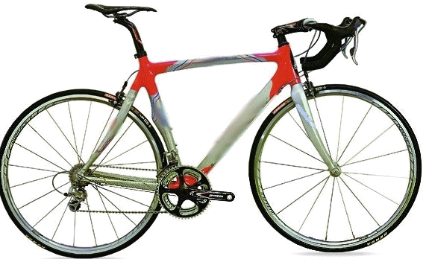
Measuring Speed
Magnet
Counting: in 10 revolutions we can tell the speed within ?? %
Measuring Time in one revolution: we call tell speed within ?.???%
Notes:
Counting: in 10 revs, we only know speed within 1 part in 10, or 10%.
But by measuring time in one revolution, we have time to the accuracy of our clock, updated every revolution!

Slide 26
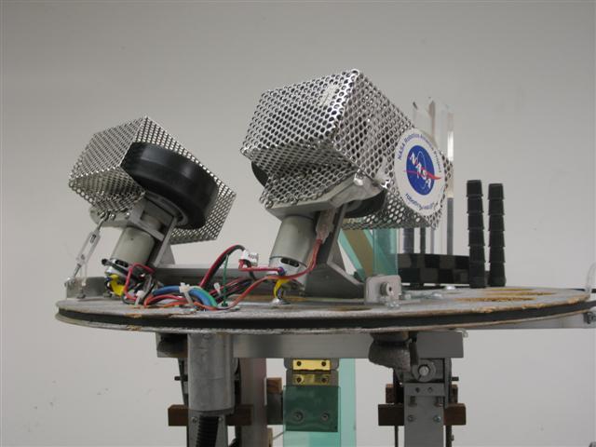
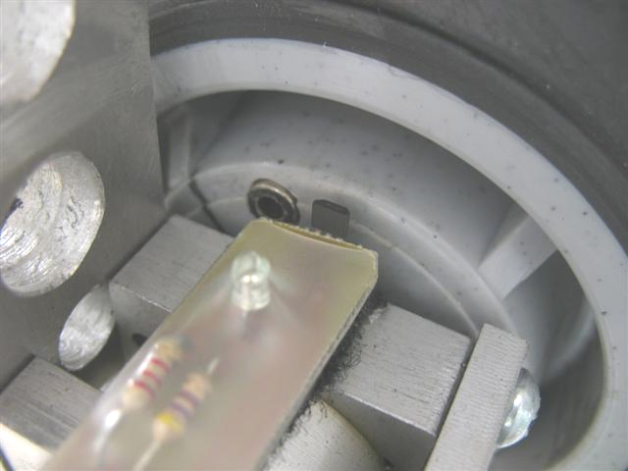
FRC2006 “Aim High”
Need for Speed Control
¼” Neodymium Magnet
Rather than determine Launch Speed vs Distance, we determined the best Launch Speed vs Vertical-Position-of-the-Target-Light-on-the-Camera.
Then we interpolated the data for all camera values in between.
Hall effect “Magnet Detector”

Slide 27
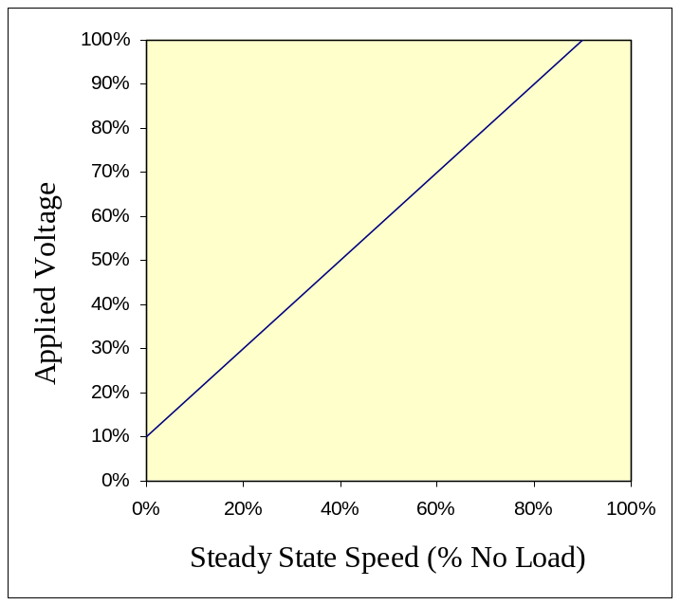
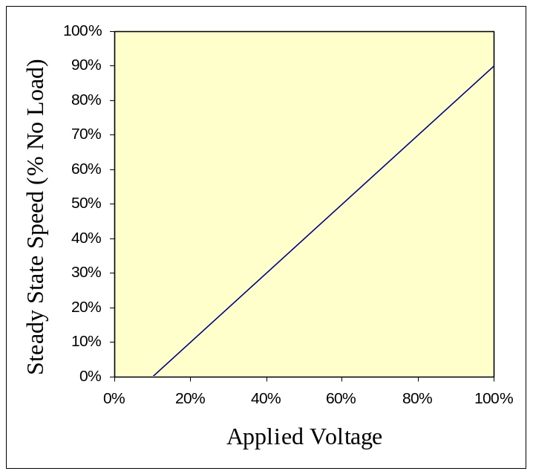
Speed Control
Make the system work Open Loop for Steady State!
+
Out
Input
Speed
Inverse E.S.C.
Transfer function
E.S.C.
−
Ideal Linear System

Slide 28
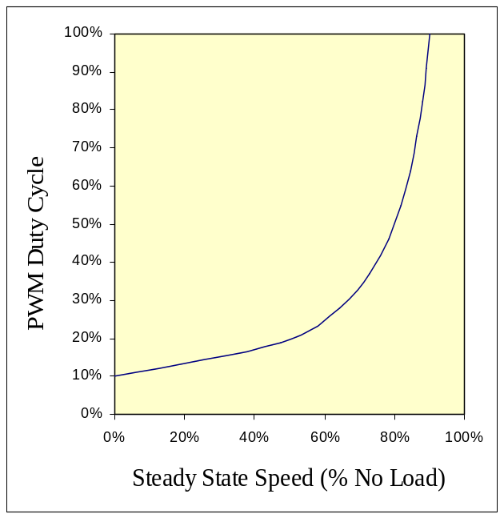
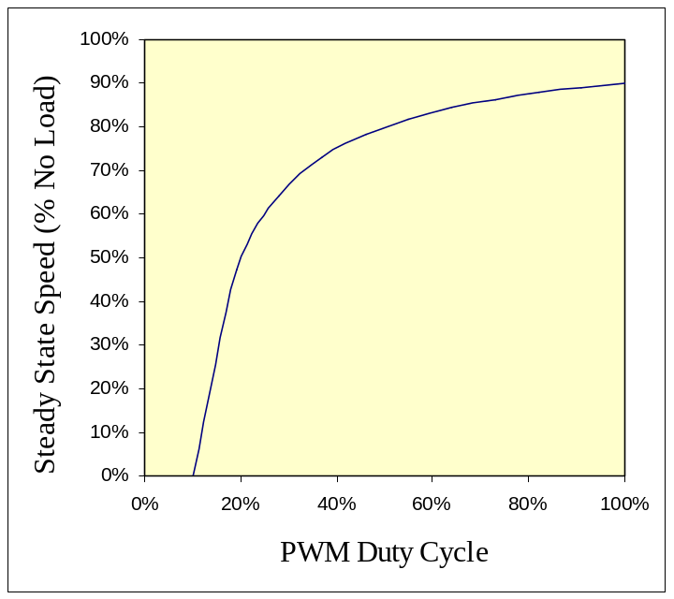
Speed Control
Make the system work Open Loop for Steady State!
+
Out
Input
Speed
Inverse E.S.C.
Transfer function
E.S.C.
−
Notes:
Transfer characteristics are for the Victor884 ESC, which operates at 120Hz. Characteristic curve is consistent with measured data and was created here from an Excel chart.

Slide 29
Revised Speed Controller
+
Controller
Out
Input
Speed
+
Inverse E.S.C.
Transfer function
E.S.C.
+
−
G
Error
Speed Sensor
+
−
Notes:
Feedback adds error correction to the open-loop design shown earlier. An alternate method would be to integrate the error in the “Textbook Speed Controller,” but integration easily causes instability.

Slide 30
Speed Controller
Psuedo Code
int RunAtSpeed(int targetSpeed, int load)
{
long gain = ReadGainSetting();
long error = targetSpeed - GetActualSpeed();
long openLoopPWM = ComputeNeededPWM(speed,load);
int outputPWM = openLoopPWM + error * gain;
return outputPWM;
}
int RunAtSpeed(int targetSpeed, int load)
{
long gain = ReadGainSetting();
long error = targetSpeed - GetActualSpeed();
long openLoopPWM = ComputeNeededPWM(speed,load);
long AdjustedGain =
gain * pwmGainAdjust(speed,load);
int outputPWM = openLoopPWM + error * AdjustedGain;
return outputPWM;
}
Conceptualized Code. Limits on values required. Will not work on your robot “As Is”. If problems persist, you should consult your mentor.
Conceptualized Code. Limits on values required. Will not work on your robot “As Is”. Consult your mentor if problems persist .

Slide 31
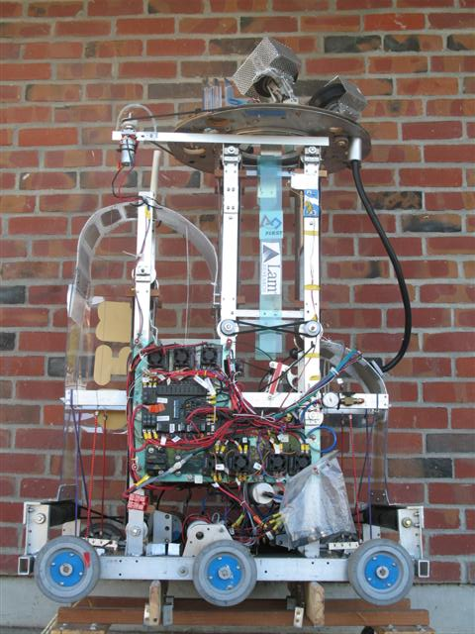
FRC2006 “Aim High”
Speed & Position Control
Triple Feedback System!
AutoTargeting Ball Launching Turret
Turret sensor: CMU2 Camera. Tracks horizontal position of green target light.
Ball Launcher System Sensor: CMU2 Camera. Based on vertical position of green target light, sets wheel speed to ‘make shot.’ based on vertical position of green target light
Ball Launch Wheel Sensor (x2): Hall Effect Used to measure wheel speed.

Slide 32
Bang-Bang Control
Two state controller (on or off). Examples:
House temperature control
Pneumatic pump on FIRST robot
We can use a three state version (up/down/off) on robotic arms or lifts. Don’t need a proportional speed controller.
Don’t overlook this simple method!
(with more time today we would be talking hysteresis)
Notes:
Good for cmd moves
Stable

Slide 33
Turning in Autonomous
(Applying closed loop control)
Method to detect turning:
  Electronic Gyro (really an angular accelerometer)
  Independent of robot’s contact with environment.
  Wheel Encoders (optical, or gear tooth detectors)
  Encoders provides distance as well.

Slide 34
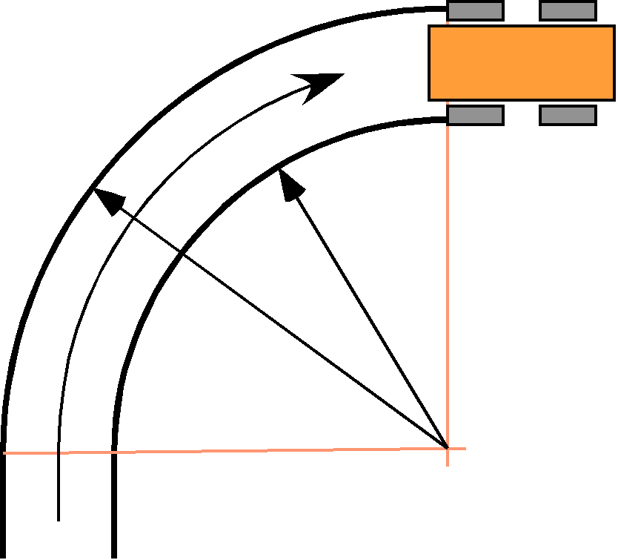

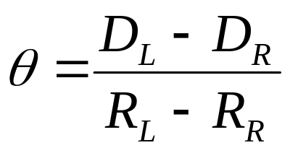
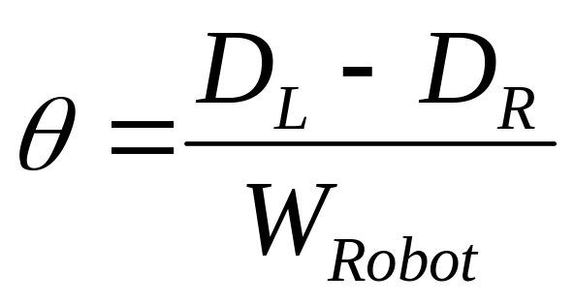
Calculating Change of Bearing
R_{R}
R_{L}
Independent of path!

Slide 35
Calculating Distance and Angle
long encoder_sum(void)
{
return gEncoders[LEFT].position + gEncoders[RIGHT].position;
}
long encoder_diff_absolute(void)
{
return gEncoders[LEFT].position - gEncoders[RIGHT].position;
}

Slide 36
Turning in Autonomous
Two methods to turn angle Ө:
Method A.
Turn angle Ө.
Settle down.
Proceed with next command.
Method B.
Add angle Ө to target bearing.
Turn to target bearing
Don’t wait to settle down!
Proceed with next command, still driving to target bearing.

Slide 37
Turning in Autonomous
typedef struct {
int turn;
int fwd;
} Drive;
boolean HeadingDistanceRun(Drive *drive,
long targetAbsDistanceLRSum, long bearingTicks, char power)
{
long currentSum = encoder_sum();
drive->turn = computeTurn(bearingTicks);
drive->fwd = power;
if (power >= 0) {
return (currentSum >= targetAbsDistanceLRSum);
} else {
return (currentSum <= targetAbsDistanceLRSum);
}
}

Slide 38
typedef struct {
int turn;
int fwd;
} Drive;
extern Drive drive;
//From main routine, call Autonomous()every 25ms;
static var currentbearing, targetbearing, targetDistance, phase;
void Autonomous() {
switch (phase){
case 1: //Setup the turn+move; Turn 90 & move 15ft
targetbearing = currentBearing + 90*kTicksPerDegree;
targetDistance = encoder_sum();
targetDistance += 15 * kTicksPerFoot;
phase++; //fall thru
case 2: //Execute the turn+move every loop until done.
if (true == HeadingDistance(drive,
targetbearing, targetDistance, kPower))
phase++;
break;
case kDoNextThing:
: //etc. etc.
} //end of switch
}
Notes:
As we repeatedly call HeadingDistance(), the robot seeks the targetbearing, and moves until the targetDistance is passed.

Slide 39
Turning in Autonomous – Recap
Maintain a TargetBearing variable for the robot.
When initiating a turn, add the desired turn amount to the TargetBearing variable.
Using a closed loop feedback system, make the robot seek the input TargetBearing.

Slide 40
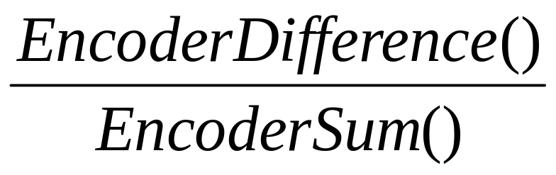
My Robot Drifts Left!
How To Drive Straight in Autonomous
Determine the required Trim:
  Clear encoder counts.
  Push robot straight as far as practical.
  Required Trim is:
Make the robot turn at rate Trim.

Slide 41
Implementing Trim
Modifying Angle Measurement
long encoder_sum(void)
{
return gEncoders[LEFT].position + gEncoders[RIGHT].position;
}
long encoder_diff_absolute(void)
{
return gEncoders[LEFT].position - gEncoders[RIGHT].position;
}
// Measure by reading the encoder difference after pushing robot
// in a straight line. e.g. bearing = -24, dist = 1106+1130, so
// ENC_TRIM = -24, ENC_TRIM_DIST = 1106+1130
#define ENC_TRIM (-24L)
#define ENC_TRIM_DIST (1106L + 1130L)
long encoder_diff_corrected(void)
{
long trim = encoder_sum() * ENC_TRIM / ENC_TRIM_DIST;
return encoder_diff_absolute() - trim;
}

Slide 42
Basic Feedback Control
Presentation available at:
<lynbrookrobotics.com>
Tech:Resources:WRRF Presentations

Slide 43
Basic Feedback Control
David Giandomenico
Team mentor for
Lynbrook Robotics – Team #846
<DGiandomenico@LynbrookRobotics.com>
Notes:
My intended audience is high school students involved actively in FIRST Robotics.
This talk covers basics of feedback control, together with discussions of practical techniques of measuring position and speed, dealing with changing loads, nonlinearities etc.

Slide 44
Understand your
Electronic Speed Controller
Determine the input/output relation. That is, what numeric input creates what % duty cycle on the output.
How? Connect oscilloscope and measure duty cycle at different numeric inputs.
Look for other peoples data especially on forums.
Remap In↔Out to remove/insert deadband as desired.

Slide 45
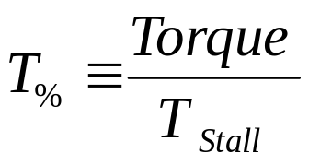
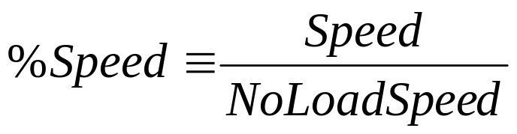
Definitions & Notes
E.S.C. – “Electronic Speed Controller”.
Victor884, Jaguar, etc.
All ‘%’ quantities are on range {0,100%}
DutyCycle_{E.S.C.} is the % time the E.S.C. is ‘on’

Slide 46
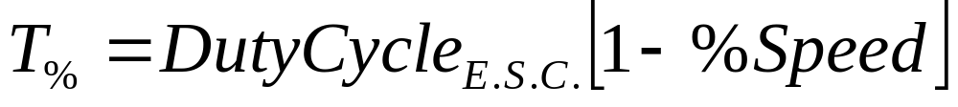

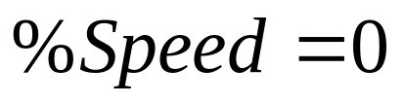

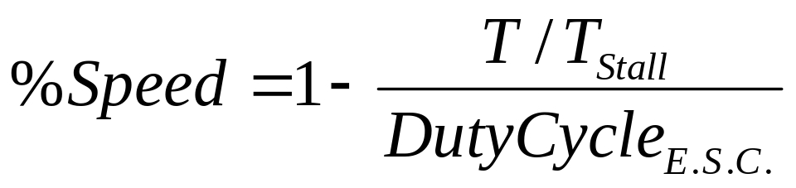
Victor884 E.S.C. ↔ Motor Characteristics
Note: Victor884 operates at 120Hz, well below the motor’s electrical time constants. The Jaguar controller operates at 15KHz which may have different characteristics.
Notes:
These are the basic steady-state characteristics for a low frequency PWM E.S.C. (such as the 120 Hz Victor884). I have not tested the Jaguar, but the higher 15KHz PWM frequency of the Jaguar will likely result in different characteristics.

Slide 47
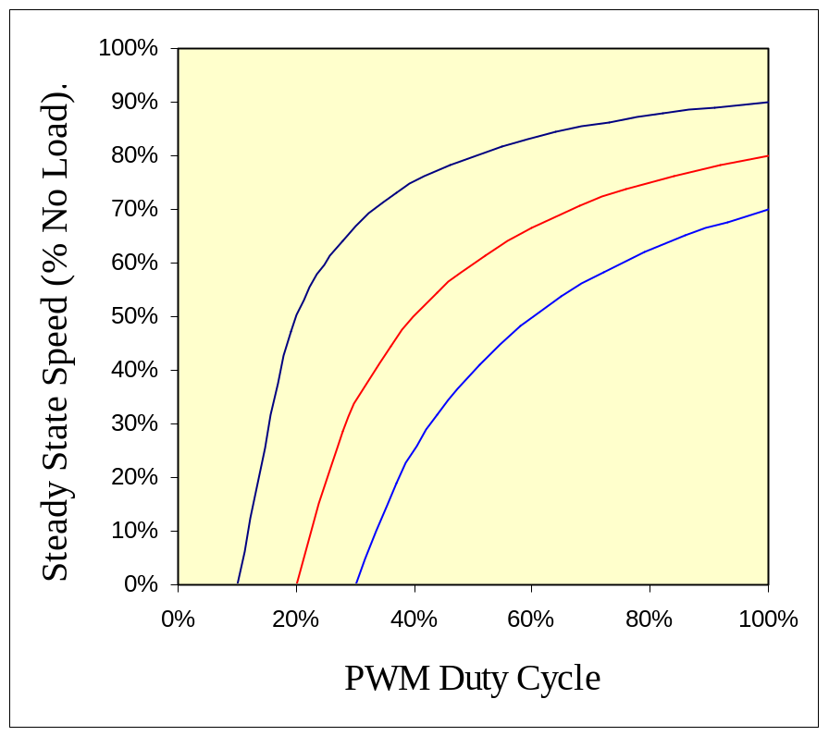
Victor884 Motor Speed vs DutyCycle
The slow 120Hz PWM frequency of the Victor884 ESC provides no ‘filtering’ of the motor current. The characteristics shown here agree well with experimental measurements.
Note: The Jaguar ESC operates at 15KHz. I have not tested this ESC yet. The higher PWM frequency may result in current filtering and may result in a more linear response.

Slide 48
Basic Feedback Control
David Giandomenico
Team mentor for
Lynbrook Robotics – Team #846
<DGiandomenico@LynbrookRobotics.com>
Notes:
My intended audience is high school students involved actively in FIRST Robotics.
This talk covers basics of feedback control, together with discussions of practical techniques of measuring position and speed, dealing with changing loads, nonlinearities etc.

